Slide 1

HEALTHCARE ANALYSIS (Using Power BI)
Presented by : Sourav Kumar Sahu
Batch No : 403
INNOMATICS RESEARCH LABS,
DILSUKHNAGAR, HYDERABAD

Slide 2
TABLE OF CONTENT
Introduction
Problem Statement
Objective
Tools and Approach
Table Information
Dashboard Overview
Data Visualizations
Conclusion

Slide 3
INTRODUCTION
Health care is a vital industry focused on improving, maintaining, and restoring the health of individuals through medical services, prevention programs, diagnostics, and treatment solutions.
Worldwide, health care systems face growing challenges like workforce shortages, rising costs, and the need for increased capacity and innovation.
Overall, health care remains a cornerstone of economic and social development, prioritizing accessible, efficient, and patient-centered care.

Slide 4
PROBLEM STATEMENT
Scattered Data: Information was spread across static spreadsheets, making analysis slow.
Lack of Clear Insights: It was difficult to track hospital performance, revenue, and patient flow in one place.
Delayed Decisions: Leadership could not get real-time data, making it hard to make fast, smart decisions.

Slide 5
OBJECTIVE
Centralize Data: To build a single, interactive dashboard in Power BI.
Track Key Metrics: To monitor KPIs like Total Revenue, Patient Volume.
Identify Trends: To find insights on admission patterns, high-revenue medical conditions, and operational efficiency, and Average Length of Stay.

Slide 6
TOOLS AND APPROACH
Tool : This entire project was built using Microsoft Power BI.
Process:
Data Connection: Loaded the hospital's raw healthcare data.
Data Modeling: Cleaned the data and created DAX measures to calculate KPIs like Total Revenue and Average Length of Stay.
Visualization: Designed this interactive dashboard with simple filters for Year and Gender.

Slide 7
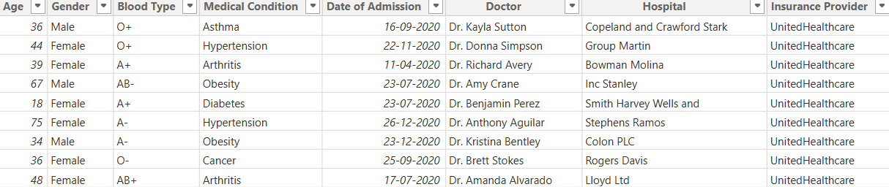
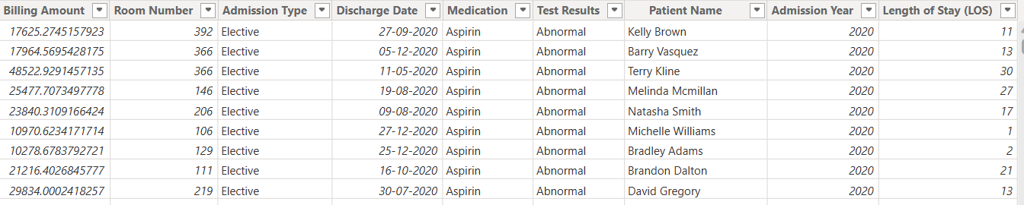
TABLE INFORMATION
Tables used : Single Table
Columns Name and their data type:
Patient name (text)
Age (int)
Gender (text)
Blood Type (text)
Medical Condition (text)
Date of Admission (Date)
Doctor (text)
Hospital (text)
Insurance Provider (text)
Billing number (int)
Room number (int)
Admission Type (text)
Discharge Date (Date)
Medication (text)
Test Results (text

Slide 8
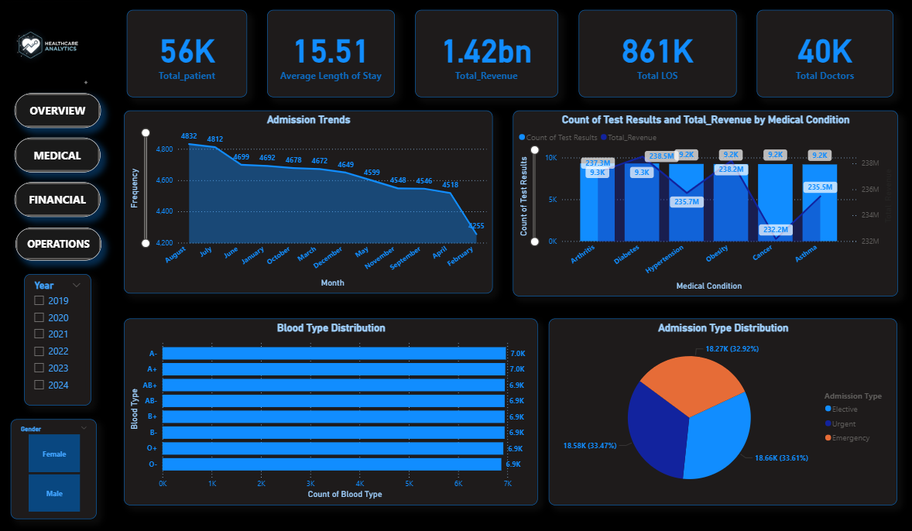
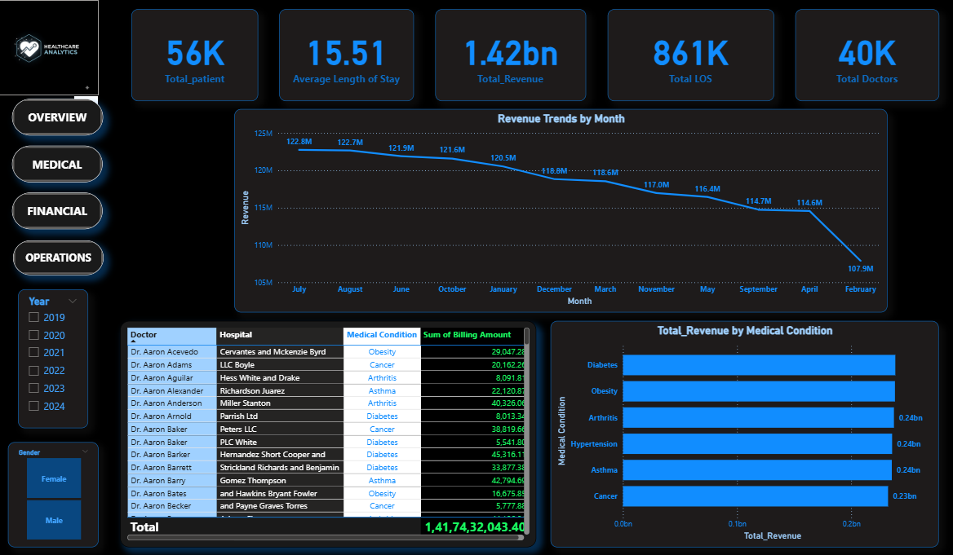
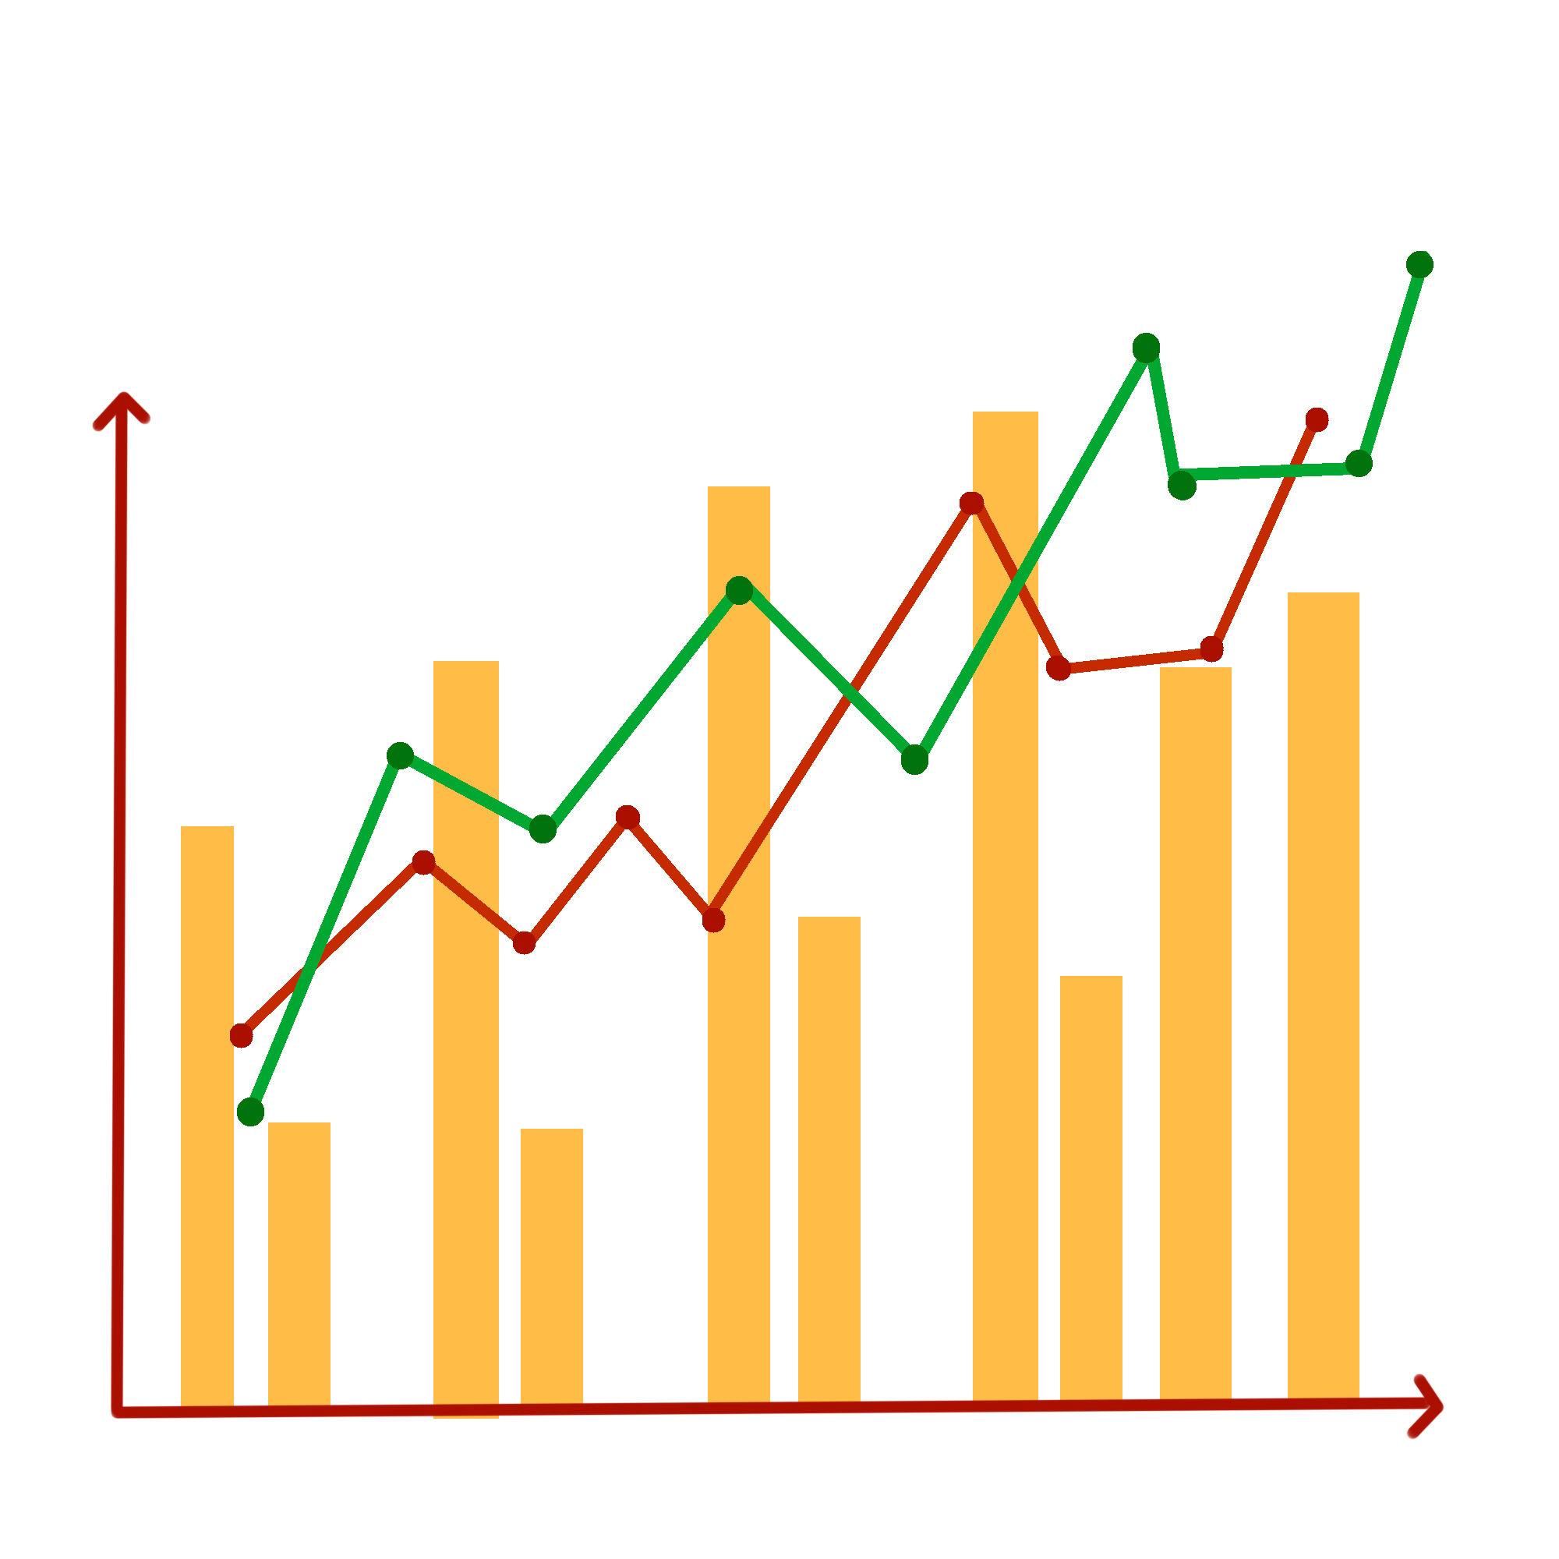
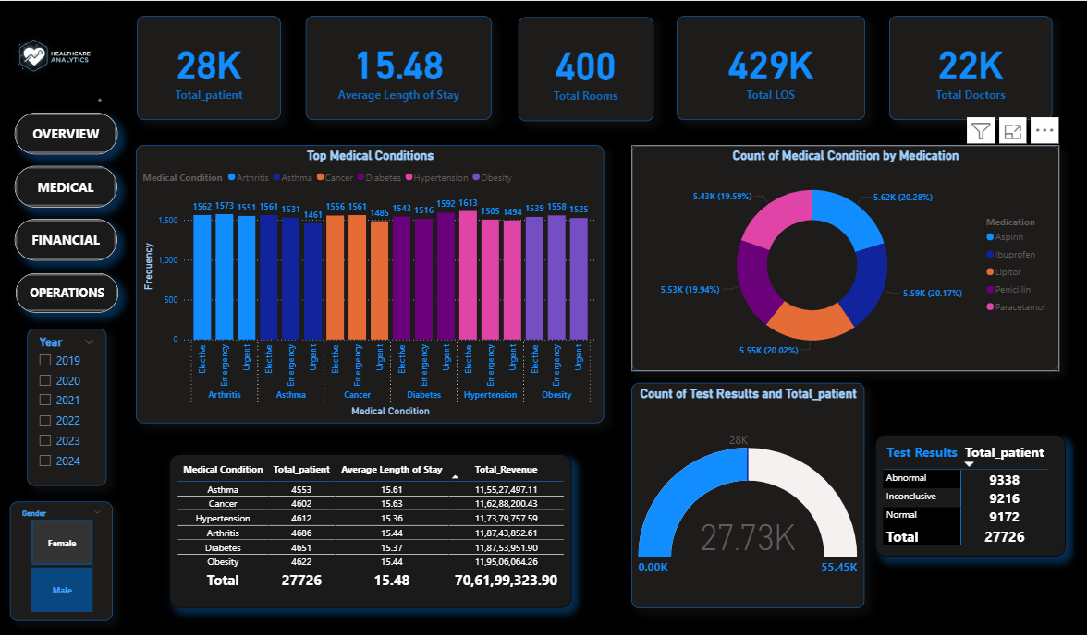
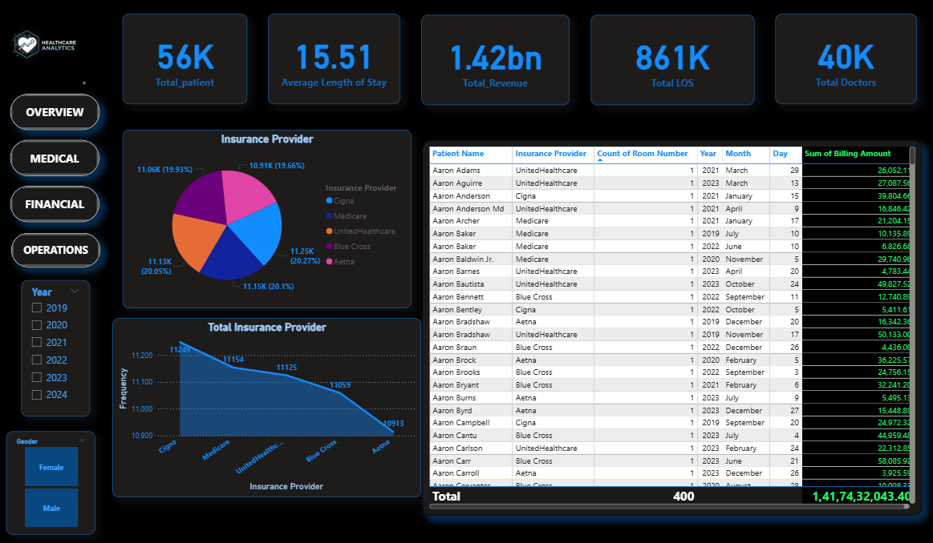
DASHBOARD OVERVIEW

Slide 9
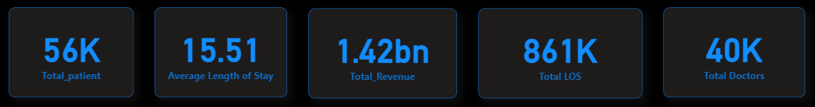
DATA VISUALIZATION
This dashboard gives us an instant summary of hospital performance:
Total Patients: We managed 56,000 patients.
Total Revenue: We generated 1.42 Billion in revenue.
Avg. Length of Stay (LOS): Patients stay 15.51 days on average.
Total Length of Stay (LOS) : Patient stays for 861000 days in total.
Total Doctors: We have 40,000 doctors in the system.

Slide 10
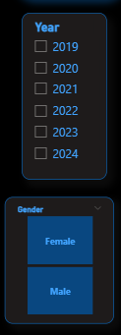
The images provided show two Power BI Slicers, which are crucial interactive components that allow users to filter the entire dashboard instantly. Their interpretation focuses on interactivity and data segmentation.
These two slicers provide essential segmentation controls for the user.
Year Slicer : Filters the entire dataset based on the date of the patient's record (e.g., Date of Admission).
Gender Slicer : Filters the entire dataset based on the patient's demographic information.

Slide 11
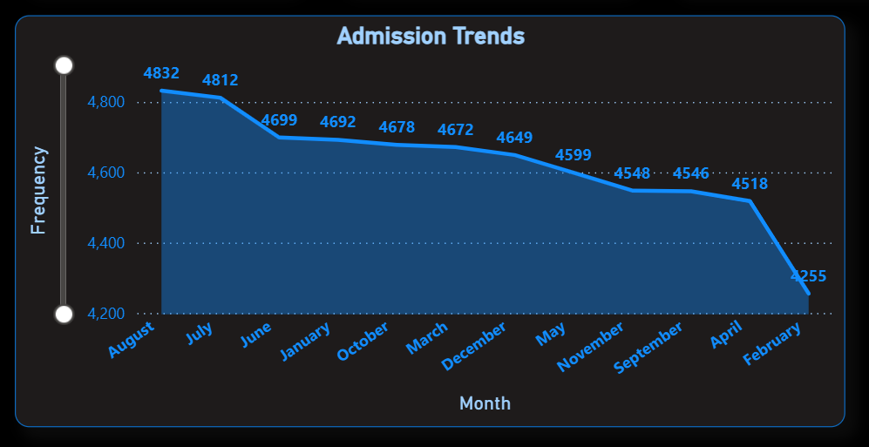
Total number of patient admitted by month
Monthly Admission Trends
August and July see peak admissions, both above 4,800 cases.
There is a steady decline in admissions from August to February, reaching a low of 4,255 in February.
The trend highlights a potential seasonal or operational pattern in admissions.

Slide 12
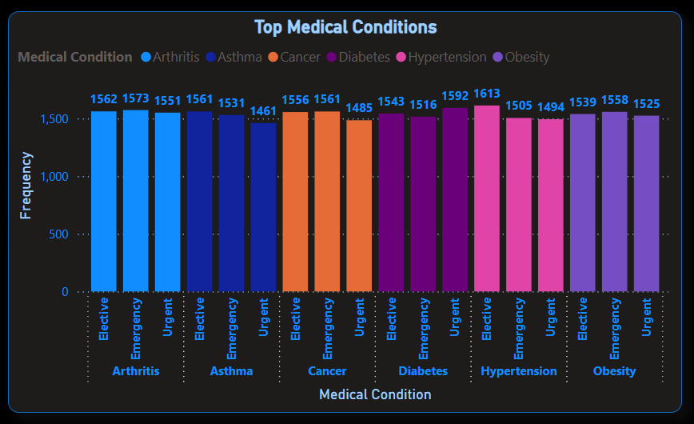
What are the Top medical condition based on their admission type ?
Hypertension has the highest frequency overall, especially for Elective (1592) and Emergency (1613) cases, showing it’s a common condition treated in both planned and emergency situations.
Asthma shows the lowest frequency for Urgent care (1461), indicating fewer urgent interventions compared to other conditions.
Most Consistent Condition: Cancer and Arthritis have nearly identical frequencies across all care types (Cancer: 1561, 1561, 1485; Arthritis: 1562, 1573, 1551), suggesting a balanced distribution between planned and unplanned treatments.

Slide 13
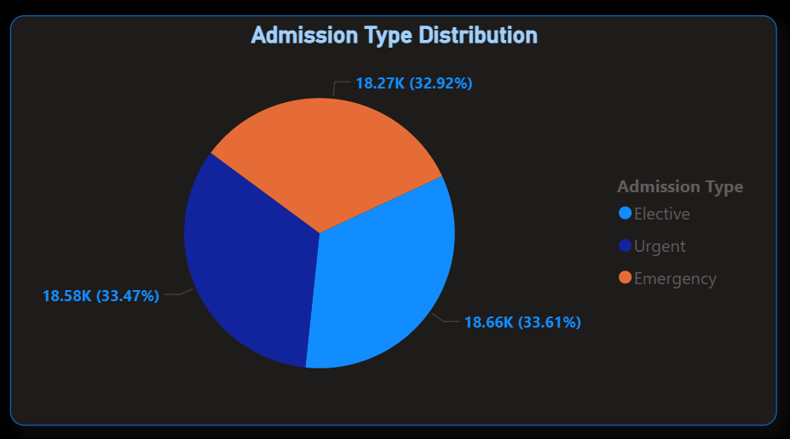
What is the highest rate of admission type ?
Admission are almost evenly distributed: Elective (33.61%), Urgent (33.47%), Emergency (32.92%).
Counts: Elective (18.66K), Urgent (18.58K), Emergency (18.27K).
Hence, Elective is having the highest rate of admission.

Slide 14
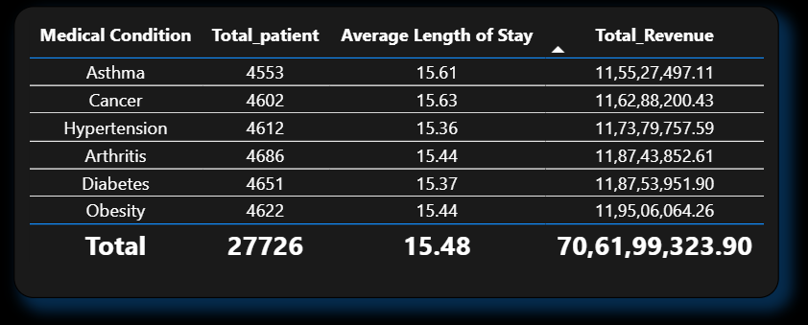
What is the Total Revenue based on the medical conditions by total patients and average length of stay ?
The patient load is remarkably balanced across all six conditions, with each having a similar patient count (approx. 4,600 patients).
Average Length of Stay is highly consistent, remaining at ~15.5 days for every condition, which suggests standardized care or billing protocols.
Obesity is the highest revenue-generating condition (11.95 Cr), while Asthma (11.55 Cr) is the lowest, even with similar patient numbers and stay durations.

Slide 15
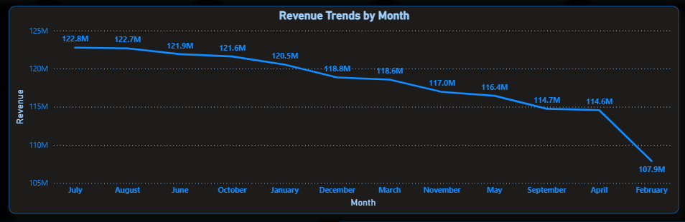
What is the total revenue generated monthly ?
Peak Revenue: Revenue is highest at the start of the fiscal year, peaking in July ($122.8M) and August ($122.7M).
Steady Decline: Revenue shows a clear, consistent downward trend throughout the year after the peak.
Lowest Point: The revenue hits its lowest point in February ($107.9M), representing a 15% drop from the July peak.

Slide 16
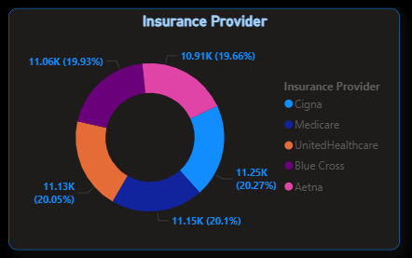
Which company provide the highest number of insurance to the patients ?
Equal Patient Split: The patient base is highly diversified and equally split among the five major insurance providers.
No Dominance: No single provider dominates the market; each carrier accounts for approximately 19.66% to 20.27% of the total patients (or around 11.0K to 11.2K patients each).
Operational Insight: Because the patient volume is so balanced, the hospital must maintain expert-level compliance and billing processes for all five carriers (Cigna, Medicare, UnitedHealthcare, Blue Cross, and Aetna) to ensure consistent reimbursement.

Slide 17
CONCLUSION
Revenue Cycle Risk Identified: We found a major trend where revenue declines consistently by 15% from the summer peak (July/August) to the winter low (February), requiring immediate attention for financial forecasting.
Operational Balance Confirmed: The hospital demonstrates high stability in core processes, evidenced by the equal patient split across all five major insurance providers and the highly consistent Average Length of Stay (15.5 days) across all medical conditions.
Data-Driven Focus Areas: The dashboard provides specific areas for resource optimization, such as scheduling to match the predictable August admission peak and investigating why Asthma generates the lowest revenue despite comparable patient volumes.

Slide 18

THANK YOU

